Slide 1

Focus Four Hazards
(Falls, Electrocution, Caught-in between, Struck-by)
This presentation of the AGC/VT in cooperation with the folks at Strengthen Training Infrastructure and Competency in Construction Safety, was created by the Trimmer Foundation under the Occupational Safety and Health Administration Susan Harwood Training Grant No. SH-18802-09-60-F-51.
Notes:
This presentation is designed to assist trainers conducting Construction Industry outreach training for workers. Since workers are the target audience, this presentation emphasizes hazard identification, avoidance, and control – not standards. No attempt has been made to treat the topic exhaustively. It is essential that trainers tailor their presentations to the needs and understanding of their audience.

Slide 2

Spring Safety Series

Slide 3
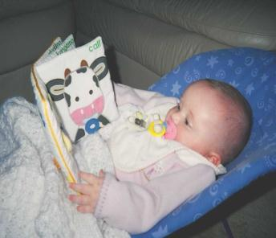
This material was produced under grant SH-18802-09-60-F-51 from the Occupational Safety and Health Administration, U.S. Department of Labor. It does not necessarily reflect the views or policies of the U.S. department of Labor, nor does mention of trade names, commercial products, or organizations imply endorsement by the U.S. Government.
Please pay attention to this program as if someone was counting on you to.
Notes:
Read text verbatim.

Slide 4
Scope and Objective
Construction can be a hazardous industry: the four hazards addressed in this class were selected because statistics show they cause 90% of all construction-related fatalities. The two main objectives of this class are, to promote a greater awareness for these hazards and secondly, to identify several Federal (and State) OSHA standards from 29 CFR 1926 that often govern these hazards.
The Focus Four Hazards are:
    Falls
    Electrical
    Struck-by
    Caught in-between (Primarily Excavation work)
Notes:
One of every five workplace fatalities is a construction worker.
Despite its high fatality rate, construction can be a safe occupation when workers are aware of the hazards, and use an effective Safety and Health Program. This class will help you identify and control the hazards that commonly cause the most serious construction injuries.

Slide 5
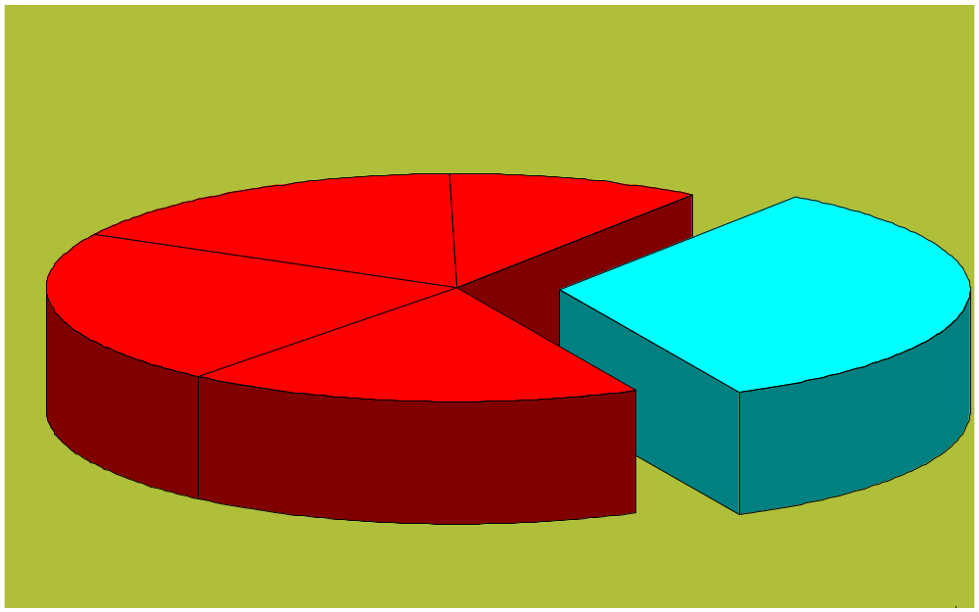
Total Construction Fatalities
Electrical 17%
Other 10%
Falls From
Elevation 33%
Struck By 22%
Caught
In/Between 18%
Almost 400 people per year
Hour No. 0.5 of 2.0

Slide 6
Fall Protection
Notes:
One of every five workplace fatalities is a construction worker.
Despite its high fatality rate, construction can be a safe occupation when workers are aware of the hazards, and use an effective Safety and Health Program. This class will help you identify and control the hazards that commonly cause the most serious construction injuries.

Slide 7
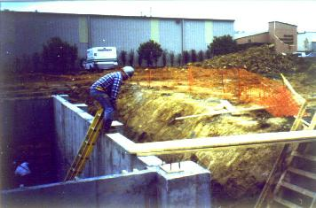
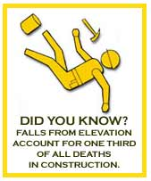
At heights of 6 feet and greater an employer has a duty to provide from 1 of 3 means of restraint.
GUARDRAIL, PERSONAL FALL ARREST
OR NETTING SYSTEM
Ref: 29 CFR 1926.501(b)(1)

Slide 8
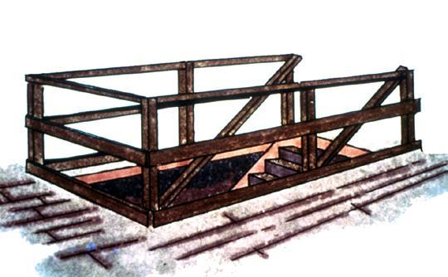
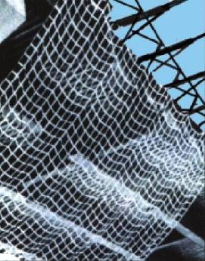
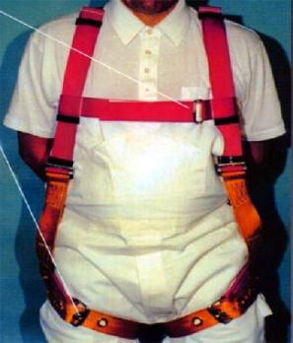
Fall Protection Options
Guardrails
Ref. 29 CFR 1926.502b
Safety Net
Ref. 29 CFR 1926.502c
Personal Fall Arrest
Ref. 28 CFR 1926.502d
Notes:
Reference 1926.501(b)(1)
General rule: If an employee can fall six feet or more onto a lower level, fall protection must be provided.
What type of fall protection will I need?
In most cases, a guardrail system, a safety net system, or a personal fall arrest system must be used. In some cases fences, barricades, covers, equipment guards or a controlled access zone may be used.
Employees must be protected not just from falling off a surface, but from falling through holes and from having objects fall on them from above.

Slide 9
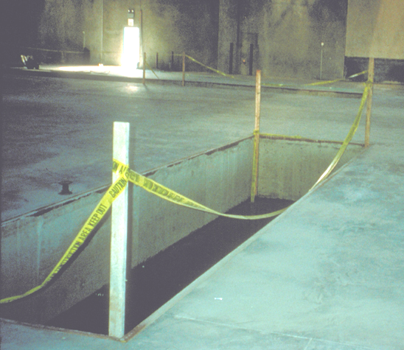
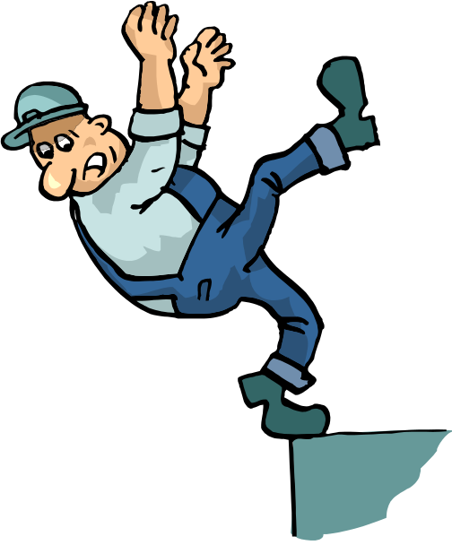
Guardrails shall comply with 29CFR1926.502(b)
GUARDRAILS
What's wrong with
this picture?

Slide 10
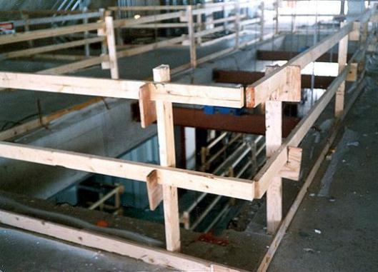
Guardrails
Top Rail
Mid- Rail
Toe board
No opening > 19”
Ref 29 CFR 1926.502(b)(2)(iv)
Top rails are to be located 42 inches in height (+/- 3 inches).
Ref 29 CFR 1926.502(b)(1)
Notes:
Reference 1926.502(b) and 1926.502(j)
How do guardrail systems protect me from falling?
Guardrail systems provide a barrier to protect the employee from falling:
Top edge of the guardrail must be 39-45 inches above the walking/working level.
There must also be protection from falling between the top rail and the walking/working surface. Midrails, screens, mesh, or intermediate vertical members may be used for this protection. There are specific requirements for their installation.
The protective barriers must be strong enough to support a falling employee. Wood, chain and wire rope may be used for top rails and midrails.

Slide 11
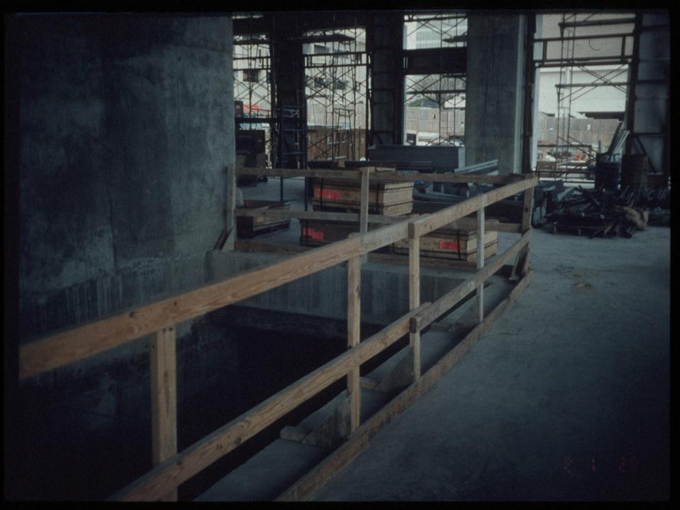
Not to exceed 8 feet
Ref. 29 CFR 1926.502
GUARDRAILSthe correct way
Top-rail withstands 200#, ref. 29 CFR 1926.502(b)(3)
Mid-rail withstands 150# Ref.502(b)(5)
Notes:
Reference 1926.501(b)(4)
Holes - 1926.501(b)(4):
Personal fall arrest systems, covers, or guardrail systems shall be erected around holes (including skylights) that are more than 6 feet above lower levels.
NOTE – All floor holes must be protected against slips/trips – even if less than 6 feet

Slide 12
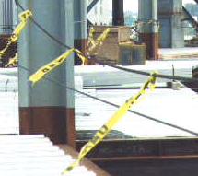
Cable or Rope Guardrails
Ref. 29 CFR 1926.502(b)(9)
Rails shall be at least 1/4” diameter to prevent cuts, etc.
Wire rope shall be flagged at not more than 6’ intervals with high-visibility materials.
Notes:
Reference 1926.502(b)
¼ inch rope is allowed, but it must meet the criteria of 1926.502(b)(3), etc.

Slide 13
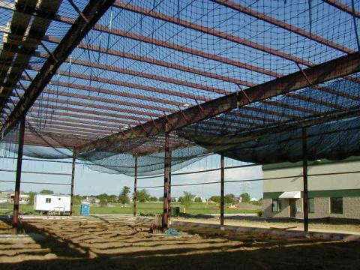
Safety Nets
Ref. 29 CFR 1926.502(c)
Nets must be set to limit falls to 30 feet.
They must be drop tested before each use.
They must cover the entire work area.
They must not allow a fallen worker to strike an object.
They must be kept clean of material and debris.
Notes:
Safety nets are a possible form of fall protection. Explain basic requirements of safety nets.
Reference 1926.502(c)
How do safety net systems protect me?
Safety net systems catch the employee if he/she does fall. The safety nets:
Must be strong enough to support a falling employee;
Must have sufficiently small mesh openings so the employee cannot fall through the net;
Must be close enough to the surface of the walking/working surface so that the fall into the safety net will not still injure the employee (never more than 30 feet below the walking/working level);
Must be close enough to the edge of the working surface (the outer edge of the net between 8-13 feet from the edge of the walking/working surface, depending on the distance to the walking/working surface) so that the falling employee will not slip past the net.

Slide 14
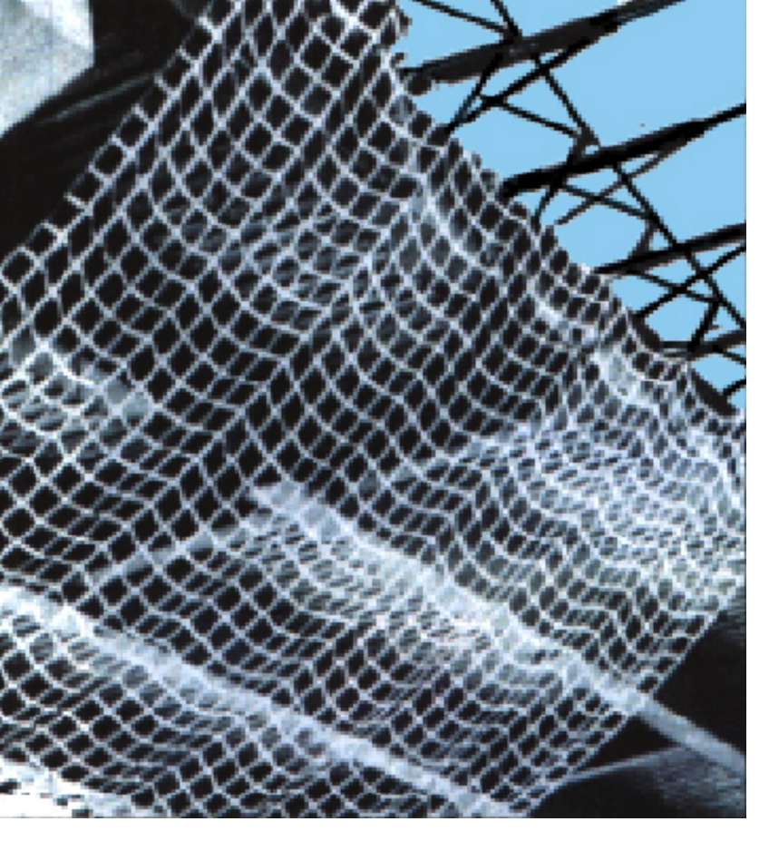
Safety Nets, cont. Ref. 29 CFR 1926.502(C)(1-9)
Installed a maximum of 30' below working level
400 pound drop test or certified by employer or CP
Extends sufficiently from outer edge
Inspected weekly
Objects removed within shift
Border rope strength of 5000 pounds
Notes:
Vertical distance from working surface to horizontal plane of net up to five feet; extend net eight feet past working edge.
Between five feet up to ten feet, extend net 10 feet past edge.
Over ten feet, extend 13 feet

Slide 15
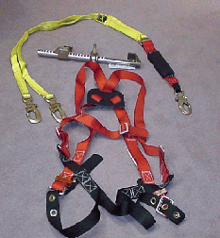
Personal Fall Arrest System
Ref. 29 CFR 1926.502(d)(1-24)
Typical PFAS consists of
  An anchorage
  Connector (Lanyard)
  A body harness
Notes:
Reference 1926.502(d)
What will my personal fall arrest system do to protect me?
A personal fall arrest system places the employee into a body harness that is fastened to a secure anchorage so that he/she cannot fall. Body belts are not acceptable as personal fall arrest systems. A few key requirements:
There should be no free fall more than 6 feet.
There should be prompt rescue after a fall.
PFAS’s must be inspected prior to each use.
PFAS’s must not be used until they have been inspected by a competent person.

Slide 16
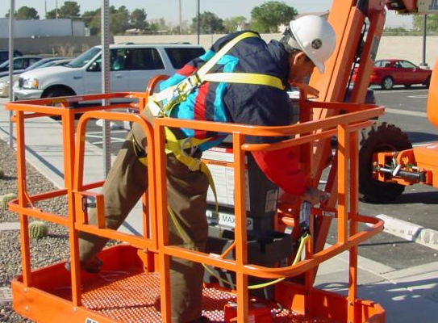
Personal Fall Arrest Systems (PFAS)
No body belts for fall arrest!
Body belts are for positioning systems only
PFAS; Is always to be
used on aerial lifts at least
When exposed to 6’ falls
Ref. 29 CFR 1926.453(b)(2)(v)
Ref. 29 CFR 1926.502 (d) & (e)
PFAS
Notes:
Effective January 1, 1998, body belts are not acceptable as part of a personal fall arrest system. Note: The use of a body belt in a positioning device system is acceptable and is regulated under paragraph (e) of section 502

Slide 17
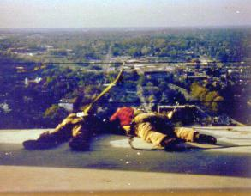
This may be an adequate guardrail supporting 200 pounds but is it good enough to support 5,000 pounds as an anchor point? Ref. 29 CFR 1926.502(d)(15)
Guardrails vs. Anchor points
Any concerns?

Slide 18

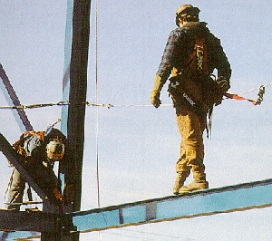
Horizontal Life Lines
Provides maneuverability.
Watch for sagging, overloading
with too many people being connected and swing hazards
Line must be designed, installed and used under the supervision of a QUALIFIED PERSON
Ref. 29 CFR 1926.502(d)(8)
It may be best to construct material on the ground first if possible then fly it in place.
Notes:
Shall be designed, installed, and used, under the supervision of a qualified person, as part of a complete personal fall arrest system, which maintains a safety factor of at least two.
You cannot just tie a cable around beams, etc.

Slide 19
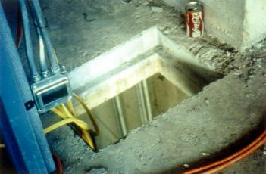
A Hole is defined as a gap or void of 2 inches or less in it’s least dimension.
Ref. 29 CFR 1926.500(b)
They may need to be covered…
Ref. 29 CFR 1926.502(i)

Slide 20
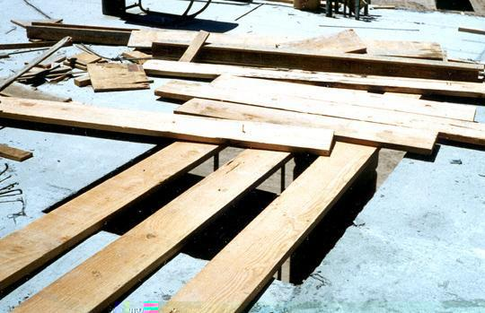
Floor Holes
Cover completely
and securely
Cover needs to be
2x any intended
loading
If no cover, can
protect with a
guardrail
Ref. 29 CFR 1926.501(b)(4)
Improperly
Covered!
Notes:
Reference 1926.501(b)(4)(i), 1926.501(b)(10), 1926.501(b)(11), and 1926.502(i)
Covers must be:
-- able to support at least twice the weight of employees, equipment, and materials that may be imposed on them at one time.
-- secured to prevent accidental displacement from wind, equipment, or workers’ activities.
-- color coded or bear the markings “HOLE” or “COVER.”
Holes - 1926.501(b)(4):
Personal fall arrest systems, covers, or guardrail systems shall be erected around holes (including skylights) that are more than 6 feet above lower levels.
NOTE – All floor holes must be protected against slips/trips – even if less than 6 feet

Slide 21
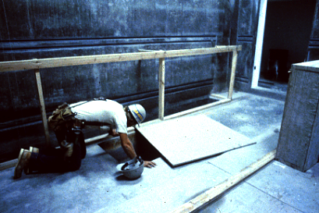
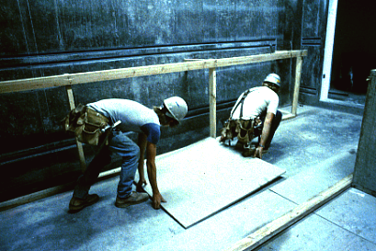
Ref. 29 CFR 1926.502 (i) Covers
Do not let this happen to you!
Mark them, secure them!

Slide 22
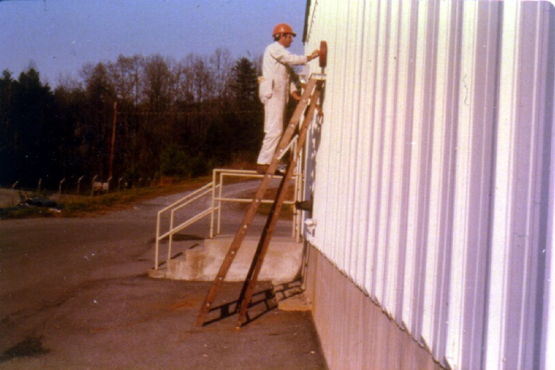
LADDERS
TO BE USED PROPERLY
Please review Subpart X - Ladders Ref. 29 CFR 1926.1053(b)(4)

Slide 23
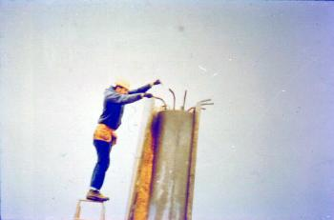
If using a ladder or Stair…then training is required…
Ref. 29 CFR 1926.1060(a)

Slide 24
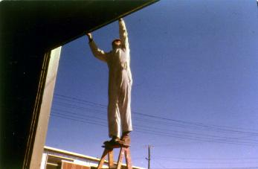
Simply wrong at work or HOME
Ref. 29 CFR 1926.1053(b)(13)

Slide 25
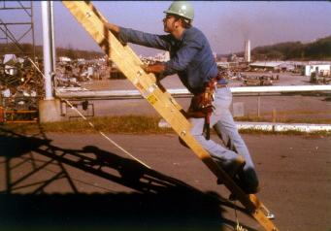
PROPER SLOPE IS 4 FEET UP FOR EVERY 1 FOOT OUT
Ref. 29 CFR 1926.1053(a)(1)(ii)

Slide 26
Misuse of Portable Ladders
Ref 29 CFR 1926.1053(b)
How to avoid hazards:
  Position portable ladders so the side rails extend at least 3 feet above the landing.
  Secure side rails at the top to a rigid support and use a grab device when 3 foot extension is not possible.
  Make sure that the weight on the ladder will not cause it to slip off its support.
Notes:
Additional Information:
29 CFR 1926 Subpart X, Ladders. OSHA Standard.
1926.1053, Ladders
1926.1053(b)(1)
Worker Deaths by Falls: A Summary of Surveillance Findings and Investigative Case Reports. US Department of Health and Human Services (DHHS), National Institute for Occupational Safety and Health (NIOSH) Publication 2000-116, (2000, September).

Slide 27
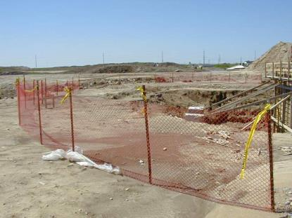
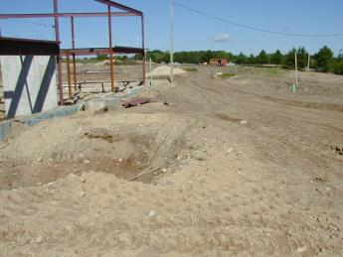
Excavations
1926.501(b)(7)
Excavations over 6 ft deep not readily seen must have barricading as a minimum
Ref. 29 CFR 1926.501(b)(7)
Good Fencing
Barricading may be Needed
Notes:
Refer to slide

Slide 28
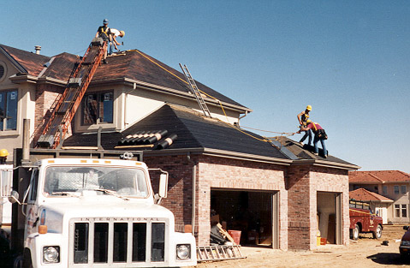
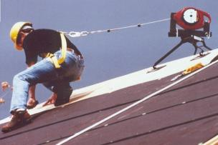
Roofs; Ref. 29 CFR 501(b)(13)
If you work on roofs and can fall
more than 6 feet, you must be protected
Notes:
Reference 1926.501(b)(10)
Reference 1926.501(b)(11) - steep roofs
Roofers - First refer to STD 3-0.1A
If workers are working on roofs with unprotected sides and edges 6 feet or more above lower levels, they shall be protected from falling by guardrail systems, safety net systems, personal fall arrest systems or a combination of a warning line system and guard-rail system, warning line system and safety net system, warning line system and personal fall arrest system, or warning line system and safety monitoring system.

Slide 29
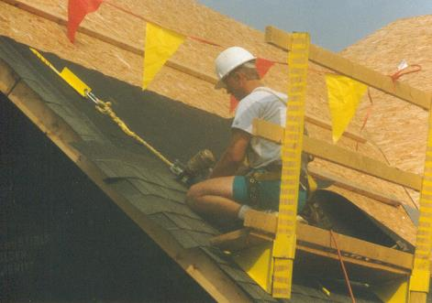
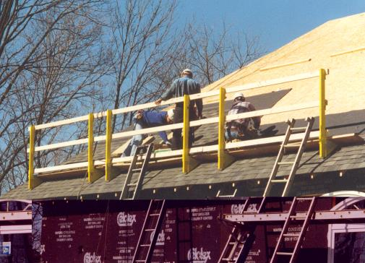
Roofing
Fall hazard training programs are required if one is exposed to a fall hazard.
Ref. 29 CFR 1926.503(a)(1) and 21(b)(2)
Notes:
Reference 1926.501(b)(10)
Reference 1926.501(b)(11) - steep roofs
Roofers - First refer to STD 3-0.1A
If workers are working on roofs with unprotected sides and edges 6 feet or more above lower levels, they shall be protected from falling by guardrail systems, safety net systems, personal fall arrest systems or a combination of a warning line system and guard-rail system, warning line system and safety net system, warning line system and personal fall arrest system, or warning line system and safety monitoring system.

Slide 30
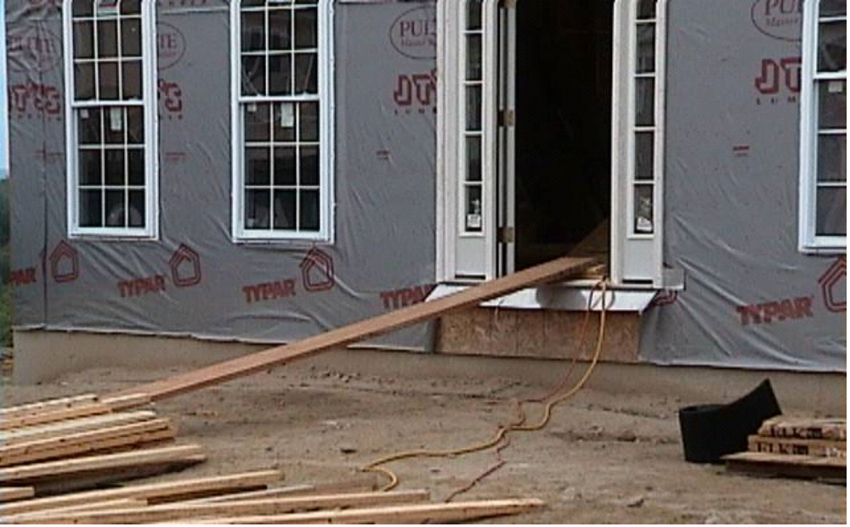
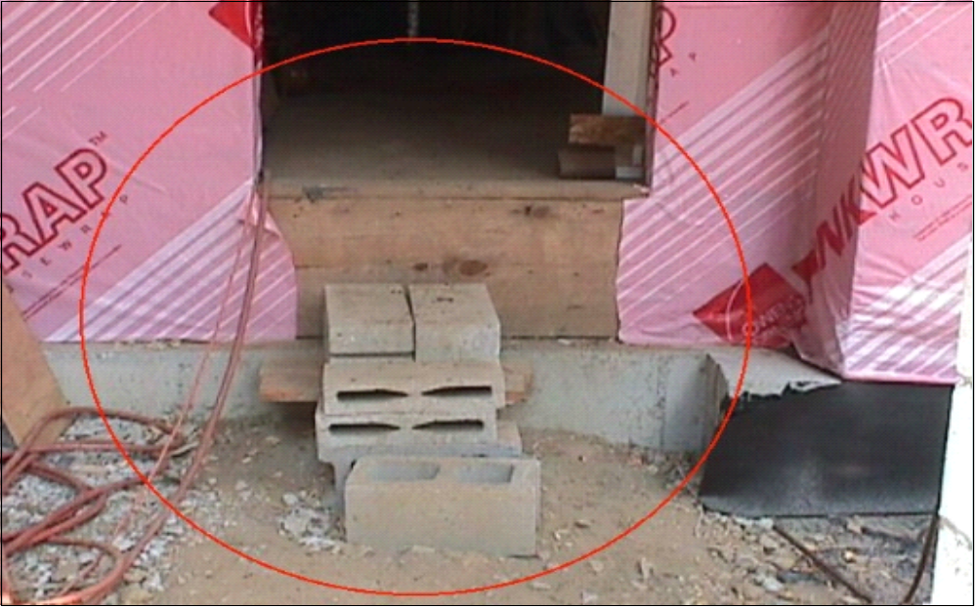
> 19” Break in elevation without a step
19” or More?
If so, this violates Federal law.
Ref. 29 CFR 1926.1051(a)
Notes:
Reference 1926.1051(a) A stairway or ladder shall be provided at all personnel points of access where there is a break in elevation of 19” or more, and no ramp, runway, slope embankment, or personnel hoist is provided.

Slide 31
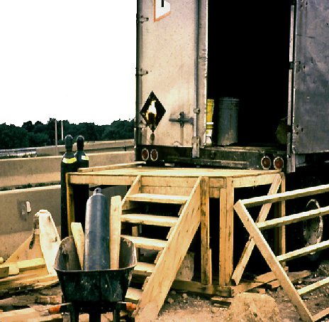
Handrails
What is wrong here?
Stairways with four or more risers, or higher than 30 inches, must be equipped with at least one handrail.
Ref. 29 CFR 1926.1052(c)(1)
Given the stairs are
Correct…
The stairway to this platform has more than 4 risers
and is not guarded. The platform requires guarding.
Notes:
Reference 1926.1052(c)
Handrails must provide an adequate handhold for employees to grasp to prevent falls. Temporary handrails must have a minimum clearance of 3” between the handrail and walls, stairrail system and other objects. OSHA has specific height requirements for handrails. Check the standard to ensure these are met during installation of handrails, stairrails and guardrails

Slide 32
1926.501(b)(2) "Leading edges."
Each employee who is constructing a leading edge 6 feet (1.8 m) or more above lower levels shall be protected from falling by guardrail systems, safety net systems, or personal fall arrest systems. Exception:
  When the employer can demonstrate that it is infeasible or creates a greater hazard to use these systems, the employer shall develop and implement a fall protection plan which meets the requirements of paragraph (k) of 1926.502.
Notes:
Definition from Sub M: Leading edge means the edge of a floor, roof, or formwork for a floor or other walking/working surface (such as the deck) which changes location as additional floor, roof, decking, or formwork sections are placed, formed, or constructed. A leading edge is considered to be an "unprotected side and edge" during periods when it is not actively and continuously under construction.

Slide 33

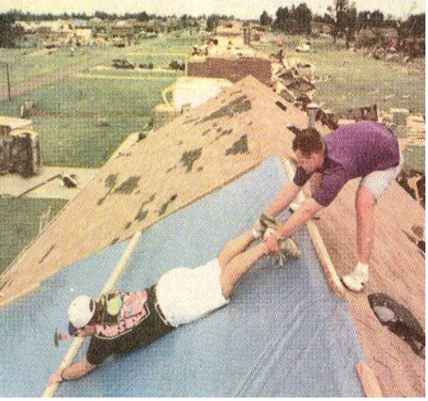
Safety Monitor
For more detail consult subpart M of 29 CFR 1926.502(h)
Able to recognize fall hazards.
Warns other employees of hazards.
Located on same surface within visual sighting distance of employees being monitored.
Close enough to communicate orally
No other responsibilities.
Only designated employees allowed in the area protected by a safety monitor.
Notes:
Reference 1926.501(b)(10)
Reference 1926.501(b)(11) - steep roofs
Roofers - First refer to STD 3-0.1A
If workers are working on roofs with unprotected sides and edges 6 feet or more above lower levels, they shall be protected from falling by guardrail systems, safety net systems, personal fall arrest systems or a combination of a warning line system and guard-rail system, warning line system and safety net system, warning line system and personal fall arrest system, or warning line system and safety monitoring system.

Slide 34
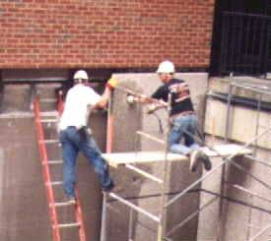
Scaffolds
(Ref. 29 CFR 1926.450 to 454)
Notes:
According to BLS, an average of 89 workers are killed from scaffolds each year.
Common hazards associated with all scaffolds: falls from elevation, due to lack of fall protection; collapse of the scaffold, caused by instability or overloading; being struck by falling tools, work materials, or debris; and electrocution, principally due to proximity of the scaffold to overhead power lines.
The majority of the workers injured in scaffold accidents attribute the accident to either planking or support giving way, or to the employees slipping or being struck by a falling object.

Slide 35
Scaffolding
How to avoid hazards:
  Use at least one of the following for scaffolds more than 10 feet above a lower level:
    Guardrail Systems
    Personal Fall Arrest Systems
    Provide safe access to scaffold platforms
  Do not climb cross-bracing as a means of access
  Ref. 29 CFR 1926.451(g)(1)
Notes:
Additional Information:
29 CFR 1926 Subpart L, Scaffolds. OSHA Standard.
1926.451, General requirements
1926.451(g)(1)
Scaffolding. OSHA eTool.
Worker Deaths by Falls: A Summary of Surveillance Findings and Investigative Case Reports. US Department of Health and Human Services (DHHS), National Institute for Occupational Safety and Health (NIOSH) Publication 2000-116, (2000, September).

Slide 36
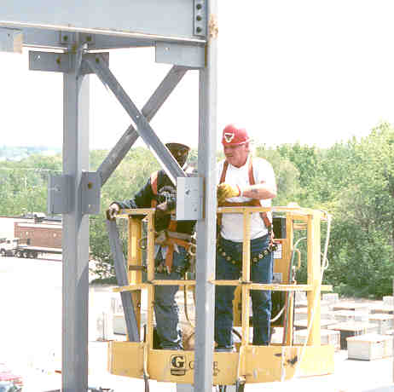
Steel Erection
Fall Protection possibly not required until heights of 15ft or 30 ft when decking or connecting.
Please review Subpart R,
of 29 CFR 1926 for additional information.
(Sections 750-761)

Slide 37
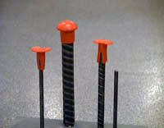
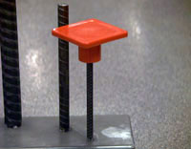
Unguarded Protruding Steel Rebar
Rebar Caps:
Ref 29 CFR 1926.701 (b)
The OSHA Standard requires that rebar "be guarded to eliminate the hazard of impalement." Not all guards provide that level of protection
In some circumstances, the force of a fall can cause rebar to push clear through a plastic cap and still impale a worker, or the worker can be impaled by the rebar and the cap together
Only rebar caps designed to provide impalement protection, such as those containing steel reinforcement, shall be used.
Notes:
Additional Information:
29 CFR 1926 Subpart Q, Concrete and masonry construction. OSHA Standard
1926.701, General requirements
1926.701(b), Reinforcing steel
Mushroom Style Plastic Rebar Covers Used for Impalement Protection. OSHA Standard Interpretation, (1997, May 29).
Worker Deaths by Falls: A Summary of Surveillance Findings and Investigative Case Reports. US Department of Health and Human Services (DHHS), National Institute for Occupational Safety and Health (NIOSH) Publication 2000-116, (2000, September).

Slide 38

Specific Requirements
Note: State and local regulation as well as contractual requirements (through consensual standards or construction user agreements) may also apply and in effect increase your expected standard of care…

Slide 39
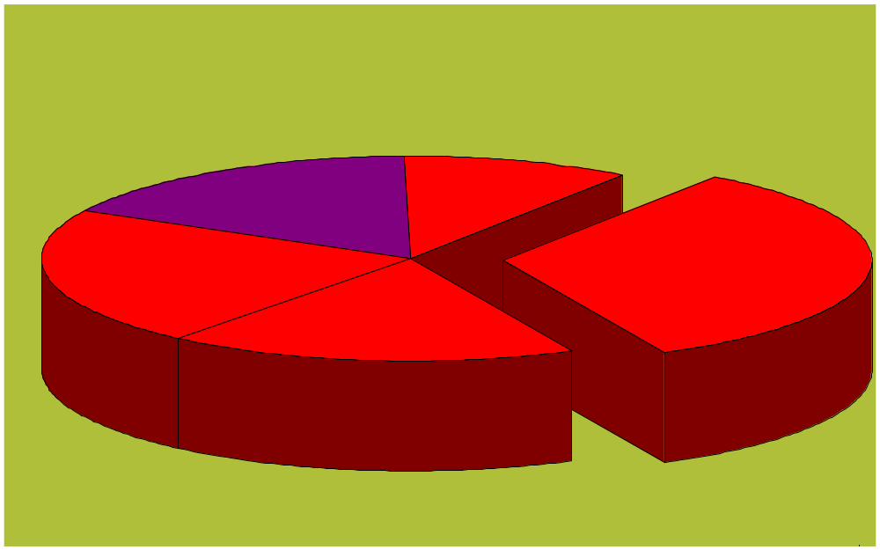
Total Construction Fatalities
Electrical 17%
Other 10%
Falls From
Elevation 33%
Struck By 22%
Caught
In/Between 18%
Hour No. 1.0 of 2.0

Slide 40

Electrical
Ref. Subpart K
29 CFR 1926.400-449
Notes:
This presentation is designed to assist trainers conducting OSHA 10-hour General Industry outreach training for workers. Since workers are the target audience, this presentation emphasizes hazard identification, avoidance, and control – not standards. No attempt has been made to treat the topic exhaustively. It is essential that trainers tailor their presentations to the needs and understanding of their audience.
This presentation is not a substitute for any of the provisions of the Occupational Safety and Health Act of 1970 or for any standards issued by the U.S. Department of Labor. Mention of trade names, commercial products, or organizations does not imply endorsement by the U.S. Department of Labor.

Slide 41
Electrical
Ref. Subpart K – 29 CFR 1926.400 through 449
The following hazards cause the most electrical injuries:
  Contact with Power Lines
  Lack of Ground-Fault Protection
  Path to Ground Missing or Discontinuous
  Equipment Not Used in Manner Prescribed
  Improper Use of Extension and Flexible Cords

Slide 42
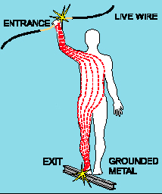
Shock Severity
Severity of the shock depends on:
  Path of current through the body
  Amount of current flowing through the body (amps)
  Duration of the shocking current through the body,
LOW VOLTAGE DOES NOT
MEAN LOW HAZARD
Notes:
Other factors that may affect the severity of the shock are:
- The voltage of the current.
- The presence of moisture
- The general health of the person prior to the shock.
Low voltages can be extremely dangerous because, all other factors being equal, the degree of injury increases the longer the body is in contact with the circuit.
The resistance of the body varies based on:
The amount of moisture on the skin (less moisture = more resistance)
The size of the area of contact (smaller area = more resistance)
The pressure applied to the contact point (less pressure = more resistance)
Muscular structure (less muscle = less resistance)

Slide 43
Electrical Injuries
!!WARNING!!
Graphic photos of actual electrical injuries follow on the next slide

Slide 44
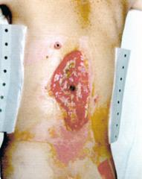
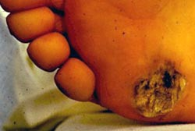
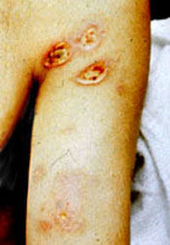
Electrical Injuries
Electrical burns cause tissue damage, and are the result of heat generated by the flow of electric current through the body. Electrical burns are one of the most serious injuries you can receive and should be given immediate attention.
Entrance Wound
Exit Wound
Arc/Flash Burns
Notes:
Entrance Wound: High resistance of skin transforms electrical energy into heat, which produces burns around the entrance point (dark spot in center of wound). This man was lucky, the current narrowly missed his spinal cord.
Exit Wound: Current flows through the body from the entrance point, until finally exiting where the body is closest to the ground. This foot suffered massive internal injuries, which weren't readily visible, and had to be amputated a few days later.
ARC/Flash Burn: This man was near a power box when an electrical explosion occurred. Though he did not touch the box, electricity arced through the air and entered his body. The current was drawn to his armpits because perspiration is very conductive.

Slide 45
Hazards & Protections – Ref 29 CFR 1926 Subpart K
Hazards
Inadequate wiring
Exposed electrical parts
Wires with bad insulation
Ungrounded electrical systems
Tools
Overloaded circuits
Damaged power equipment
Using the wrong PPE
Overhead powerlines
Electrical hazards may be
made worse by wet conditions…
Protective Measures
Proper grounding
Use GFCI’s
Use fuses and circuit breakers
Guard live parts
Lockout/Tagout
Proper use of flexible cords
Close electric panels
Training

Slide 46
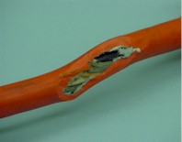
Clues that Electrical Hazards Exist
Tripped circuit breakers or blown fuses
Warm tools, wires, cords, connections, or junction boxes
GFCI that shuts off a circuit
Worn or frayed insulation around wire or connection
Notes:
There are “clues” that electrical hazards exist. For example, if a GFCI keeps tripping while you are using a power tool, there is a problem. Don’t keep resetting the GFCI and continue to work. You must evaluate the “clue” and decide what action should be taken to control the hazard.
There are a number of other conditions that indicate a hazard.
Tripped circuit breakers and blown fuses show that too much current is flowing in a circuit. This could be due to several factors, such as malfunctioning equipment or a short between conductors. You need to determine the cause in order to control the hazard.
An electrical tool, appliance, wire, or connection that feels warm may indicate too much current in the circuit or equipment. You need to evaluate the situation and determine your risk.
An extension cord that feels warm may indicate too much current for the wire size of the cord. You must decide when action needs to be taken.
A cable, fuse box, or junction box that feels warm may indicate too much current in the circuits.
A burning odor may indicate overheated insulation.
Worn, frayed, or damaged insulation around any wire or other conductor is an electrical hazard because the conductors could be exposed. Contact with an exposed wire could cause a shock. Damaged insulation could cause a short, leading to arcing or a fire. Inspect all insulation for scrapes and breaks. You need to evaluate the seriousness of any damage you find and decide how to deal with the hazard.
A GFCI that trips indicates there is current leakage from the circuit First, you must decide the probable cause of the leakage by recognizing any contributing hazards. Then, you must decide what action needs to be taken.

Slide 47
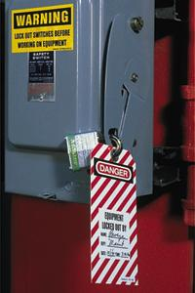
Locking and tagging of circuits
Controls to be deactivated during the course of work on energized or deenergized equipment or circuits shall be locked and tagged.
Placed at all energy source locations
Ref. 29 CFR 1926.417
Notes:
Equipment or circuits that are deenergized shall be rendered inoperative and shall have tags attached at all points where such equipment or circuits can be energized.
Tags shall be placed to identify plainly the equipment or circuits being worked on.

Slide 48
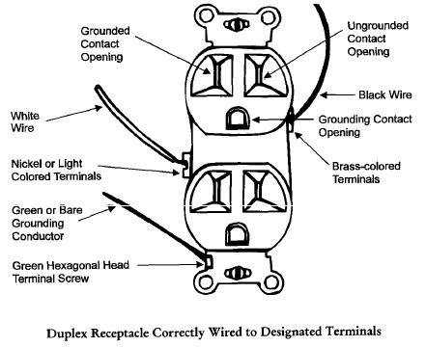
Proper wiring methods:
Ref. 29 CFR 1926.405

Slide 49
Assured Equipment Grounding Conductor Program
Program must cover:
  All cord sets
  Receptacles not part of a building or structure
  Equipment connected by plug and cord
Program requirements include:
  Specific procedures adopted by the employer
  Competent person to implement the program
  Visual inspection for damage of equipment connected by cord and plug
  Ref. 29 CFR 1926.404(b)(1) for information on required Branch circuit ground fault protection assured equipment grounding conductor program.
Notes:
Reference 1926.404(b)(1)(iii)
Assured Equipment Grounding Conductor Program (AEGCP).
The employer shall establish and implement AEGCP on construction sites covering all listed above which are available for use or used by employees. This program has the following minimum requirements:
- Daily visual inspections,
- Periodic test inspections (3 months at most for temporary cords and cords exposed to damage, 6 months for fixed cords not exposed)
- Written description,
- A competent person to implement the program, and
- Record of the periodic tests.
When portions of the building(s) or structures(s) which have been completed and no longer expose employees to weather or damp and wet locations, or to other grounding hazards, GFCIs or an assured equipment grounding program may not be required when approved extension cords are plugged into the permanent wiring at construction sites.

Slide 50
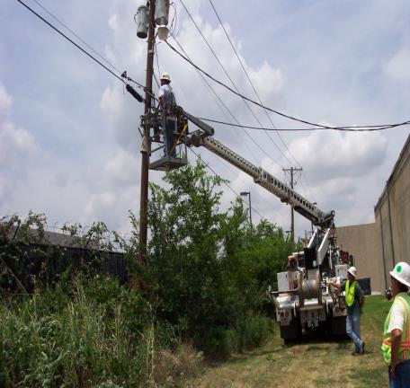
Overhead Power Lines
Stay at least 10 feet away
Ref. 29 CFR 1926.955(b)(8).
Assume that lines are energized
Use wood or fiberglass ladders, not metal
Power line workers need special training & PPE
Power lines can be buried, so call before you dig
Notes:
1926.416(a)
How Do I Avoid Hazards?
-- Look for overhead power lines and buried power line indicators. Post warning signs.
-- Contact Dig Safe and/or utilities for buried power line locations.
-- Stay at least 10 feet away from overhead power lines.
-- Unless you know otherwise, assume that overhead lines are energized.
-- Get the owner or operator of the lines to de-energize and ground lines when working near them.
-- Other protective measures include guarding or insulating the lines.
-- Use non-conductive wood or fiberglass ladders when working near power lines.

Slide 51
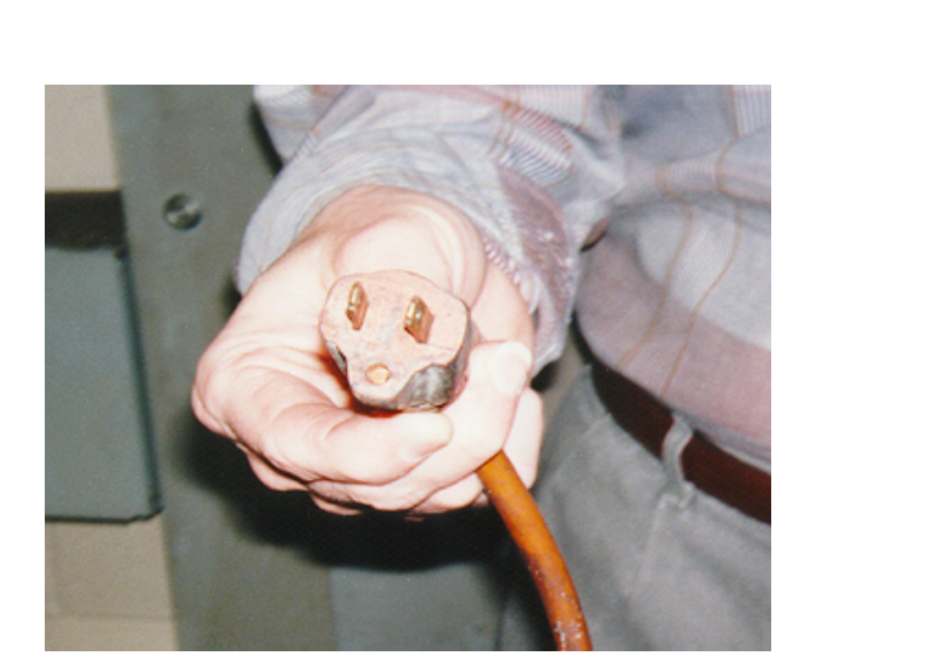
Grounding Path
The path to ground from circuits, equipment, and enclosures must be permanent and continuous
Violation shown here is an extension cord with a missing grounding prong
  Ref. 29 CFR 1926.404(e) - Over current
  Ref. 29 CFR 1926.404(f) - Grounding
Notes:
1910.304(f)(4)

Slide 52

Types of GFCI’s
Cord Connected type:
Attachment plug incorporates the GFCI module.
Protects the cord, and any equipment attached to the cord.
Attachment has non-standard appearance
Equipped with test and reset buttons.
No-voltage release feature, Ref. 29 CFR 1926.404(b)(1)(ii)

Slide 53
Lack of Ground Fault Protection
How to avoid hazards:
  Use ground-fault circuit interrupters (GFCI) on all 120-volt, single-phase, 15- and 20-ampere receptacles, or have an assured equipment grounding conductor program (AEGCP).
  Follow manufacturers' recommended testing procedure to insure GFCI is working correctly.
  Use double-insulated tools and equipment, distinctively marked.
Notes:
Additional Information:
29 CFR 1926 Subpart K, Electrical. OSHA Standard.
1926.404, Wiring and design protection.
1926.404(b)(1)(i)
Electrical Safety: Safety and Health for Electrical Trades Student Manual. US Department of Health and Human Services (DHHS), National Institute for Occupational Safety and Health (NIOSH) Publication No. 2002-123, (2002, January).
Electrical Contractors Industry. OSHA Safety and Health Topic Page. Provides information about the hazards that electrical workers may experience as a part of their jobs.

Slide 54

Specific Requirements
Note: State and local regulation as well as contractual requirements (through consensual standards or construction user agreements) may also apply and in effect increase your expected standard of care…

Slide 55

Total Construction Fatalities
Electrical 17%
Other 10%
Falls From
Elevation 33%
Struck By 22%
Caught
In/Between 18%
Hour No. 1.5 of 2.0

Slide 56
Struck-By
The second highest cause of construction-related deaths is being struck by an object. Approximately 75% of struck-by fatalities involve heavy equipment such as trucks or cranes.
Safety and health programs would be wise to take into account the many ways struck-by accidents can occur.
Notes:
One in four "struck by vehicle" deaths involve construction workers, more than any other occupation.

Slide 57
Struck-By
The following three hazards cause the most
struck-by injuries:
  Vehicles, Subpart “O” of 29 CFR 1926 (600-606)
  Falling/Flying Objects
  Constructing Masonry Walls Ref. 29 CFR 1926 (700 through 706)

Slide 58

Vehicles
If vehicle safety practices are not observed at your site, you risk being pinned between construction vehicles and walls, struck by swinging backhoes, crushed beneath overturned vehicles, or other similar accidents. If you work near public roadways you risk being struck by trucks or cars.
This accident may have happened because the excavation was not properly barricaded
Notes:
Additional Information:
29 CFR 1926 Subpart G, Signs, signals, and barricades. OSHA Standard.
1926.201, Signaling
29 CFR 1926 Subpart O, Motor vehicles, mechanized equipment, and marine operations. OSHA Standard
1926.601, Motor Vehicles
Work Zone - Best Practices Guidebook. Federal Highway Administration (FHWA).

Slide 59
Vehicles
How to avoid hazards:
  Wear seat belts that meet OSHA standards except on equipment that is designed only for standup operation, or that has no rollover protective structure. Ref. 29 CFR 1926.602(a)(2)(i)
  Check rigging equipment before each shift to assure that all parts and accessories are in safe operating condition.
  Ref. 29 CFR 1926.251(a)(1)
  Do not drive a vehicle in reverse gear with an obstructed rear view, unless it has an audible reverse alarm, or another worker signals that it is safe. Ref. 29 CFR 1926.602(a)(9)(ii)
  Drive vehicles or equipment only on roadways or grades that are safely constructed and maintained. Ref. 29 CFR 1926.602(a)(3)(i)
Notes:
Additional Information:
29 CFR 1926 Subpart G, Signs, signals, and barricades. OSHA Standard.
1926.201, Signaling
29 CFR 1926 Subpart O, Motor vehicles, mechanized equipment, and marine operations. OSHA Standard
1926.601, Motor Vehicles
Work Zone - Best Practices Guidebook. Federal Highway Administration (FHWA).

Slide 60
Vehicles
How to avoid hazards:
  Do not carry personnel unless there is a safe place to ride.
  Use traffic signs, barricades (Ref. 29 CFR 1926. 202) or flaggers (Ref. 29 CFR 1926.201) when construction takes place near public roadways.
  Workers must be highly visible in all levels of light. Warning clothing, such as red or orange vests, are required; and if worn for night work, must be of reflective material. (Ref. 29 CFR 1926.201(a)
Notes:
Additional Information:
29 CFR 1926 Subpart G, Signs, signals, and barricades. OSHA Standard.
1926.201, Signaling
29 CFR 1926 Subpart O, Motor vehicles, mechanized equipment, and marine operations. OSHA Standard
1926.601, Motor Vehicles
Work Zone - Best Practices Guidebook. Federal Highway Administration (FHWA).

Slide 61

Falling/Flying Objects
You are at risk from falling objects when you are beneath cranes, scaffolds, etc., or where overhead work is being performed. There is a danger from flying objects when power tools, or activities like pushing, pulling, or prying, may cause objects to become airborne. Injuries can range from minor abrasions to concussions, or death. Ref. 29 CFR 1926.100
These workers are not protected
from being struck by falling
objects because they are
working around/under other
workers and not
wearing hardhats
Notes:
Additional Information:
29 CFR 1926 Subpart E, Personal protective and lifesaving equipment. OSHA Standard.
1926.100, Head protection
1926.100(a)
1926.102, Eye and face protection
1926.102(a), General
29 CFR 1926 Subpart H, Materials handling, storage, use, and disposal
1926.250, General requirements for storage
1926.250(a), General. OSHA Standard.
29 CFR 1926 Subpart L, Scaffolds. OSHA Standard.
1926.451, General requirements
1926.451(h), Falling object protection
29 CFR 1926 Subpart N, Cranes, derricks, hoists, elevators, and conveyors
1926.550, Cranes and derricks
1926.550(g)(4)(ii)(F)

Slide 62

Falling/Flying Objects
How to avoid hazards – General
  Wear hardhats. Ref. 29 CFR 1926.100(a)
  Stack materials to prevent sliding, falling, or collapse.
  Use protective measures such as toeboards and debris needed Ref. 29 CFR 1926 Subpart M
  For Demolition Ref. 29 CFR 1926 Subpart “T”…an engineering survey prior to operations needed
Notes:
Additional Information:
29 CFR 1926 Subpart E, Personal protective and lifesaving equipment. OSHA Standard.
1926.100, Head protection
1926.100(a)
1926.102, Eye and face protection
1926.102(a), General
29 CFR 1926 Subpart H, Materials handling, storage, use, and disposal
1926.250, General requirements for storage
1926.250(a), General. OSHA Standard.
29 CFR 1926 Subpart L, Scaffolds. OSHA Standard.
1926.451, General requirements
1926.451(h), Falling object protection
29 CFR 1926 Subpart N, Cranes, derricks, hoists, elevators, and conveyors
1926.550, Cranes and derricks
1926.550(g)(4)(ii)(F)

Slide 63

Falling/Flying Objects ref. 29 CFR 1926.95-102
How to avoid hazards – Power Tools/Machines
  Use safety glasses, goggles, face shields, etc., where machines or tools may cause flying particles.
  Inspect tools, such as saws and lathes, to insure that protective guards are in good condition.
  Ref. 29 CFR 1926.102(a)(1)
  Make sure you are trained in the proper
  operation of powder actuated tools.
  Ref. 29 CFR 1926.302(e)(1)
Notes:
Additional Information:
29 CFR 1926 Subpart E, Personal protective and lifesaving equipment. OSHA Standard.
1926.100, Head protection
1926.100(a)
1926.102, Eye and face protection
1926.102(a), General
29 CFR 1926 Subpart H, Materials handling, storage, use, and disposal
1926.250, General requirements for storage
1926.250(a), General. OSHA Standard.
29 CFR 1926 Subpart L, Scaffolds. OSHA Standard.
1926.451, General requirements
1926.451(h), Falling object protection
29 CFR 1926 Subpart N, Cranes, derricks, hoists, elevators, and conveyors
1926.550, Cranes and derricks
1926.550(g)(4)(ii)(F)

Slide 64

Falling/Flying Objects
How to avoid hazards – Cranes & Hoists
  Avoid working underneath loads being moved.
  Barricade hazard areas and post warning signs.
  Inspect cranes and hoists to see that
  all components, such as
  wire rope, lifting hooks,
  chains, etc., are in good condition.
  Do not exceed lifting capacity of
  cranes and hoists. Ref. 29 CFR 1926.550
Notes:
Additional Information:
29 CFR 1926 Subpart E, Personal protective and lifesaving equipment. OSHA Standard.
1926.100, Head protection
1926.100(a)
1926.102, Eye and face protection
1926.102(a), General
29 CFR 1926 Subpart H, Materials handling, storage, use, and disposal
1926.250, General requirements for storage
1926.250(a), General. OSHA Standard.
29 CFR 1926 Subpart L, Scaffolds. OSHA Standard.
1926.451, General requirements
1926.451(h), Falling object protection
29 CFR 1926 Subpart N, Cranes, derricks, hoists, elevators, and conveyors
1926.550, Cranes and derricks
1926.550(g)(4)(ii)(F)

Slide 65

Suggestive measures to reduce Falling/Flying Objects
How to avoid hazards – Overhead Work
  Secure tools and materials to prevent them from falling on people below.
  Barricade hazard areas and post warning signs.
  Use toeboards, screens, or guardrails on scaffolds to prevent falling objects, or,
  Use debris nets, catch platforms,
  or canopies to catch or deflect
  falling objects.
Notes:
Additional Information:
29 CFR 1926 Subpart E, Personal protective and lifesaving equipment. OSHA Standard.
1926.100, Head protection
1926.100(a)
1926.102, Eye and face protection
1926.102(a), General
29 CFR 1926 Subpart H, Materials handling, storage, use, and disposal
1926.250, General requirements for storage
1926.250(a), General. OSHA Standard.
29 CFR 1926 Subpart L, Scaffolds. OSHA Standard.
1926.451, General requirements
1926.451(h), Falling object protection
29 CFR 1926 Subpart N, Cranes, derricks, hoists, elevators, and conveyors
1926.550, Cranes and derricks
1926.550(g)(4)(ii)(F)

Slide 66

Constructing Masonry Walls
Ref. Subpart Q
Constructing concrete and masonry walls is especially dangerous because of the tremendous loads that need to be supported. There are risks of major accidents, and even death, when jacks or lifting equipment are used to position slabs and walls, or when shoring is required until structures can support themselves.
These workers are constructing a masonry wall – what hazards are they being exposed to?
Notes:
Additional Information:
29 CFR 1926 Subpart Q, Concrete and masonry construction. OSHA Standard.

Slide 67
Constructing Masonry Walls
Ref. Subpart Q
How to avoid hazards
  Do not place construction loads on a concrete structure until a qualified person indicates that it can support the load.
  Adequately shore or brace structures until permanent supporting elements are in place, or concrete has been tested to assure sufficient strength.
Notes:
Additional Information:
29 CFR 1926 Subpart Q, Concrete and masonry construction. OSHA Standard.

Slide 68

Specific Requirements
Note: State and local regulation as well as contractual requirements (through consensual standards or construction user agreements) may also apply and in effect increase your expected standard of care…

Slide 69

Total Construction Fatalities
Electrical 17%
Other 10%
Falls From
Elevation 33%
Struck By 22%
Caught
In/Between 18%
Hour No. 2.0 of 2.0

Slide 70

Excavation
Cave-ins are perhaps the most feared trenching hazard. Life threatening hazards include suffocation, squeezing, caught in between, and electrocution or explosions by contact with underground utilities.
OSHA requires that workers in trenches and excavations be protected by sloping, shoring or shielding.
Ref. 29 CFR 1926.650-652 Subpart “P”
A father and son were killed when this trench collapsed

Slide 71

Danger !!
Working in excavations is one of the most hazardous construction operations.
Most accidents occur in trenches 5-15 feet deep
There is usually no warning before a cave-in
On average a worker has 6-8 minutes to live if buried alive.

Slide 72
Excavations
The following hazards cause the most excavation related caught in between injuries:
  No Protective System
  Failure to Inspect Trench and Protective Systems
  Unsafe Spoil-Pile Placement
  Unsafe Access/Egress
  Ref. 29 CFR 1926.651
Notes:
The fatality rate for excavation work is 112% higher than the rate for
general construction

Slide 73
Competent Person
“One who is capable of identifying existing and predictable hazards in the surroundings or working conditions which are unsanitary, hazardous, or dangerous to employees, and who has the authorization to take prompt corrective measures to eliminate them”. Ref. 29 CFR 1926.32(f)
A Competent person has many specific duties with respect to excavation safety.
Notes:
Refer to slide

Slide 74

Competent Person
Per the Excavation standard’s Preamble:
A competent Person must have had specific training in and be knowledgeable about:
  Soils classification
  The use of protective systems
  The requirements of the standard
Must be capable of identifying hazards, and authorized to immediately eliminate hazards
Notes:
Reference 1926.650(b) "Competent person"
One who is capable of identifying existing and predictable hazards in the surroundings, or working conditions which are unsanitary, hazardous, or dangerous to employees, and who has authorization to take prompt corrective measures to eliminate them.
Preamble Page 45909 – “Competent Person”
The term is used throughout existing subpart P, but was not defined within the subpart, and there were no references to the existing definition in subpart C, in the proposal, OSHA added the definition to subpart P to help those using the standard.

Slide 75
Areas of responsibility under Subpart “P”
Ref. 29 CFR 1926.651
Stability of adjacent structure
Protection of employees from loose rock or soil
Inspections (Visual/manual)
Fall protection
Spoil pile
Condition of trench and protective system materials
Water removal system
Classify soil
Surface encumbrances
Underground installations
Access and egress
Exposure to vehicular traffic
Exposure to falling loads
Warning system for mobile equipment
Hazardous atmospheres
Monitor protection from water accumulation
Monitor effects of surcharge

Slide 76

Inspections of Excavations
A competent person must make daily inspections of excavations, areas around them and protective systems: Ref. 29 CFR 1926.651(k)
  Before work starts and as needed to reinspect,
  After rainstorms, high winds or other occurrence which may increase hazards, and
  When you can reasonably anticipate an employee will be exposed to hazards.
Notes:
Reference 1926.651(k)
Daily inspections of excavations, the adjacent areas, and protective systems shall be made by a competent person for evidence of a situation that could result in possible cave-ins, indications of failure of protective systems, hazardous atmospheres, or other hazardous conditions. An inspection shall be conducted by the competent person prior to the start of work and as needed throughout the shift. Inspections shall also be made after every rainstorm or other hazard increasing occurrence. These inspections are only required when employee exposure can be reasonably anticipated.

Slide 77

Ref.29 CFR 1926.651(b)
Call before you dig!!

Slide 78

Means of Egress
A stairway, ladder, or ramp must be in trenches that are 4 or more feet deep, and within 25 ft of employees
Ref. 29 CFR 1926.651(c)
The ladder should extend 3 feet
above the point of access.
Notes:
A stairway, ladder, or ramp must be present in excavations that are 4 feet or more in depth to provide workers with a safe means for getting in and out of the excavation. A ladder, ramp, stairway or other safe means of egress must be within 25 feet or all employees working in a trench. The maximum distance between ladders and/or other means of egress in 50 feet. All ladders must be secure and extend at least 3 feet above the point of access. Workers should never be permitted to ride in excavator/backhoe buckets to get in and out of an excavation.

Slide 79

Access / Egress
You tell me...good/bad?
If trenches at 4 feet and greater must access by stair, ladder or ramp.
Ref. 29 CFR 1926.651(c)(2)

Slide 80
Three S’s of Trench Safety
5ft or greater (unless stable rock) must have…
Shield - a structure able to withstand a cave-in and protect employees
Shoring - a structure that supports the sides of an excavation and protects against cave-ins
Sloping - a cut using a specific angle of incline on the sides of the excavation. The angle varies based on assessment of impacting site factors. This may include benching but not in type “C” soil
Ref. 29 CFR 1926.652(a)(1) for protective system requirement
Notes:
Reference 1926.650
Shield (shield system) -- a structure able to withstand a cave-in and protect employees with the structure. Shields can be permanent structure or can be designed to be portable and moved along as work progresses. Also known as trench box or trench shield.
Shoring (shoring system) -- a structure such as a metal hydraulic, mechanical or timber shoring system that supports the sides of an excavation and which is designed to prevent cave-ins.
Sloping (sloping system) -- protects employees from cave-ins by excavating to form sides of an excavation that are inclined away from the excavation to prevent cave-ins. The angle of incline varies with differences in such factors as the soil type, environmental conditions of exposure, and application of surcharge loads.

Slide 81

Slope, Shore or Shield
So what were the 3 S's?

Slide 82

Secondary Failures:
ARE Very HAZARDOUS

Slide 83

TENSION CRACKS
ALSO
Very HAZARDOUS!

Slide 84



Simple Sloping
Ref. 29 CFR 1926.652 Appendix B
Type A - 3/4:1
    53 degrees
Type B - 1:1
    45 degrees
Type C - 1½ :1
    34 degrees
The competent person shall classify the soil by visual and manual tests
Please see subpart “P” of 29 CFR 1926 for more information

Slide 85


Benching
Ref. 29 CFR 1929.652 Appendix B
Type A
Type B
Type C >>>>>>>>> None Permitted
NA

Slide 86

Failure to Inspect Trench and Protective System
If trenches and excavations at your site are not inspected daily and after a hazardous occurrence for evidence of possible cave-ins, hazardous atmospheres, failure of protective systems, or other unsafe conditions, you are in danger and violate Federal law Ref. 29 CFR 1926.651
Before being allowed to enter an excavation, competent persons must ensure it is inspected
Notes:
Additional Information:
29 CFR 1926 Subpart P, Excavations. OSHA Standard.
1926.652, Requirements for protective systems
Trench Safety. Auburn University Engineering Extension.
Additional Examples

Slide 87
Failure to Inspect Trench and Protective System
Ref. 29 CFR 1926.651(k)
How to avoid hazards: Inspect excavations:
    Before construction begins.
    Daily before each shift.
    As needed throughout the shift.
    Following rainstorms or other hazard-increasing events (such as a vehicle or other equipment approaching the edge of an excavation).
Notes:
Additional Information:
29 CFR 1926 Subpart P, Excavations. OSHA Standard.
1926.651, Specific excavation requirements
1926.651(k), Inspections
Trench Safety. Auburn University Engineering Extension.

Slide 88
Unsafe Spoil Pile Placement
Ref. 29 CFR 1926.651(j)(2)
How to avoid hazards:
  Provide protection by one or more of the following:
    Set spoils and equipment at least 2 feet back from the excavation.
    Use retaining devices, such as a trench box, that will extend above the top of the trench to prevent equipment and spoils from falling back into the excavation.
    Where the site does not permit a 2-foot set back, spoils may need to be temporarily hauled to another location.
Notes:
. Additional Information:
29 CFR 1926 Subpart P, Excavations. OSHA Standard.
1926.651, Specific excavation requirements
1926.651(j)(2)
Trench Safety. Auburn University Engineering Extension.

Slide 89

There is a 2’ set-back for spoil material in order to protect from falling or rolling materials.
Ref. 29 CFR 1926.651(j)(2)

Slide 90

Hazard awareness
Understanding that a cubic yard of soil can weigh up to 3000 pounds,
What other hazard to you see on the next three slides?
Notes:
Point out to your crew - That a single cubic yard of dirt weighs between 3000 and 4000 pounds - more than a small pickup truck.
From: Beware of the excavation rats - Part 2 by Michael W. Hayslip - article linked at the end of this presentation

Slide 91


Slide 92


Slide 93


Slide 94
No Protective System
How to avoid hazards
  Preplan; contact utilities (gas, electric) to locate underground lines, plan for traffic control if necessary, determine proximity to structures that could affect choice of protective system.
  Provide safe access into and out of the excavation.
  Provide appropriate protections if water accumulation is a problem
Notes:
Additional Information:
29 CFR 1926 Subpart P, Excavations. OSHA Standard.
1926.652, Requirements for protective systems
Trench Safety. Auburn University Engineering Extension.
Additional Examples

Slide 95
No Protective System
How to avoid hazards
  Test for low oxygen, hazardous fumes and toxic gases, especially when gasoline engine-driven equipment is running, or the dirt has been contaminated by leaking lines or storage tanks. Insure adequate ventilation or respiratory protection if necessary.
  Inspect the site daily at the start of each shift, following a rainstorm, or after any other hazard-increasing event.
  Keep excavations open the minimum amount of time needed to complete operations.
Notes:
Additional Information:
29 CFR 1926 Subpart P, Excavations. OSHA Standard.
1926.652, Requirements for protective systems
Trench Safety. Auburn University Engineering Extension.
Additional Examples

Slide 96

Specific Requirements
Note: State and local regulation as well as contractual requirements (through consensual standards or construction user agreements) may also apply and in effect increase your expected standard of care…

Slide 97


Note: This material was not intended to serve as an exhaustive list of all relevant Focus Four type Hazards or Federal OSHA Standards. Attendees are strongly encouraged to seek out additional resources for training, guidance and support.
Thank you for your time and
attention to this program…
Stay safe for all of us.

