Slide 1
Managing Unannounced
Visit from OSHA

Slide 2
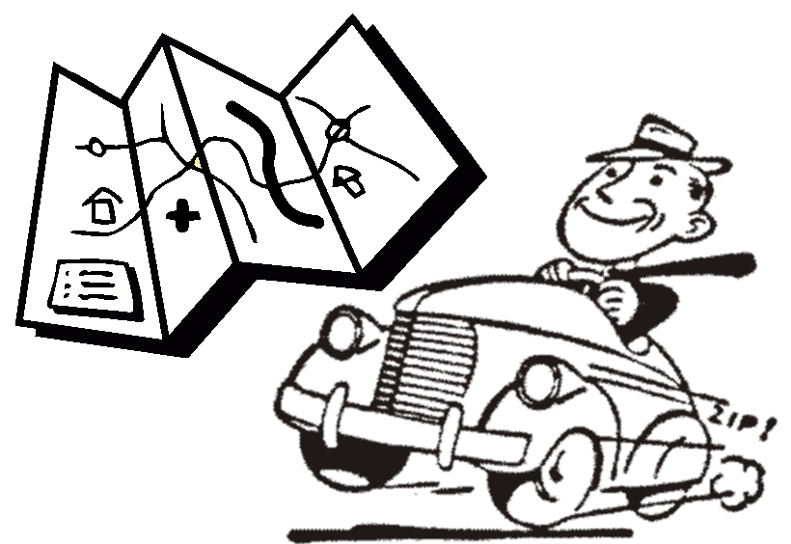
Road Map
Why OSHA visits
Understanding the inspection process
Preparing for the OSHA visit
Managing the unannounced visit from OSHA
Top 10 OSHA Citations
OSHA’s Temporary Worker Initiatives

Slide 3

Why OSHA Visits: Inspection Priority
Imminent Danger
Fatality/Catastrophe
Complaint/Referrals
Targeted Inspections
Follow-up inspections
Notes:
Imminent Danger
Reasonable certainty that an immediate danger exists
Life threatening
Fatality/Catastrophe
Reported to OSHA
Inspected as soon as possible
Complaint/Referrals
Worker may file a complaint
Worker representative may file a complaint
Referred from any entity
Targeted Inspections
Local Emphasis Program, National Emphasis Program
High injury/illness rate
Severe violator
Specific hazards or industries
Follow-up inspections

Slide 4
Understanding the Process
Identification
Opening conference
Walkaround
Interviews
Closing Conference

Slide 5
Identification
CSHO must show credentials
OK to follow company policies
Right to “representation”
Notes:
CSHO must show credentials
OK to ask for credentials if they forget to show them
OK to call regional office & confirm official business
They should never charge a fee during their visit
OK to follow company policies
Write down Officer’s name
Please have a seat (don’t direct them to a location across your facility)
I’ll need to call corporate office
Right to “representation”
Our Safety Manager will be here in 30 minutes
Employees have the right to representation
Employee rep can walk around with inspector
Employee can talk privately with inspector
Employees can point out hazards and describe injuries, illnesses, near misses resulting from those hazards
Employees can find out about inspection results

Slide 6
Opening Conference
CSHO identifies the purpose of the visit
May ask for basic company information
Likely to ask for certain files
CSHO will list the scope of the inspection
Notes:
CSHO identifies the purpose of the visit
Programmed Inspection
Response to a complaint (may provide you with a copy)
Accident investigation-Reported
Rights explained
May ask for basic company information
Leadership structure
Contact information
Type of work completed
Number of Employees
CSHO will list the scope of the inspection
Machines
Procedures

Slide 7

The Walkaround
Provide Officer with necessary PPE
Officer decides the course of the inspection
Accompany the Officer
Correct anything you can on the spot
Notes:
Likely to ask for certain files
Provide Officer with necessary PPE
Officer decides the course of the inspection
Area of incident
Production flow, start to finish
“Wall to Wall”
“Top down”
Machine of interest
Accompany the Officer
Take notes of Officer’s observations
Take pictures of the same things
Ask clarifying questions
Correct what you can on the spot
The Officer may first ask if there are unique dangers in the facility. Be prepared to provide PPE for the Officer. Providing PPE shows that you’re really committed to safety and that requirements extend to them.
Taking photos ensures both have a record of the conversation.
http://www.safetyandhealthmagazine.com/articles/11995-preparing-for-an-osha-inspection?page=2

Slide 8
Interviews
The Officer will most likely conduct interviews
  Several employees
  Several management employees
Provide a private area
Interviews:
  Last about 10-15 minutes
  Generally cover training topics
  May cover safety and health questions
Notes:
The Officer may ask to privately interview several employees
Have your previously chosen private area selected and ready for use
Interviews:
Last about 10-15 minutes
Generally cover training topics:
What training have you received
Where are SDSs maintained
If you need to evacuate where do you go
Do you feel safe in your work area
May cover safety and health questions
Have you gotten sick when handling…

Slide 9
Closing Conference
Inspection Recap
Officer reviews general findings with you
May ask follow-up questions and summarize expected documents
May allow you to ask questions
May discuss courses of action the employer may take
Results
Up to six months to issue citation and proposed penalties
Notes:
Statute of Limitations: “…No citation may be issued under this Section after the expiration of six months following the occurrence of any violation.”

Slide 10
Closing Conference
CSHOs shall:
Discuss apparent violations
Provide, Employer Rights and Responsibilities Following a Federal OSHA Inspection
Discuss the strengths and weaknesses of the employer’s safety and health programs
Advise employer and employee of their rights
Notes:
CSHOs shall:
Discuss apparent violations and other pertinent issues
Give employers the publication, Employer Rights and Responsibilities Following a Federal OSHA Inspection
Discuss the strengths and weaknesses of the employer’s occupational safety and health system and any other applicable programs
Advise employer and employee of their rights to participate in any subsequent conferences, meeting or discussions

Slide 11
After the Closing Conference
CSHO writes up findings and reviews with Area Manager
Determines validity of findings
Proposed penalties
Sends letter containing citations and penalties to you
15 working days to contest
  Must post citations for employee review
  Must post intention to contest
Notes:
Employees can

Slide 12


Preparing for an OSHA Visit
Audit your program (where do you stand?):
What’s your safety culture like?
Do you have an active, written safety program?
Have you completed a JHA?
Notes:
Mention OSHA’s pamphlet on conducting a Job Hazard Analysis.

Slide 13
Preparing for an OSHA Visit
  Audit your program - continued
Any past citations? Have they been corrected?
Review Injury/Illness history
  OSHA Logs
  Work Comp Loss Runs & Trend Reports
  Look for trends:
    Specific equipment
    Specific process
    Specific time of day

Slide 14
Sidebar
How effective is the program?
Incidence Rate
Experience Modification Rate
IR = (Injuries + Illnesses) x 200,000 Hours
Total Hours Worked

Slide 15
Preparing for an OSHA Visit
Correct deficiencies that the audit identified
Continuous improvement
Safety Committee
  Management
  Employee

Slide 16
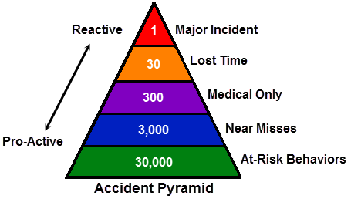
Preparing for an OSHA Visit
Continuous improvement - continued
Lean Manufacturing
  5 S Program
  Six Sigma
TQM
Systems Safety approach (NASA/Boeing)
Near-miss investigations – “Freebie”
Accident Investigation Program (learn from mistakes)

Slide 17

Preparing for an OSHA Visit
Prepare based on reasons for OSHA visits:
  Preventing Imminent Danger
    3-Es
      Engineer
      Educate
      Enforce
    Document 3-Es
    Regular safety audits
      Safety committee
      Management
Notes:
Focus on engineering controls, not PPE

Slide 18

Preparing for an OSHA Visit
Prepare based on reasons for OSHA visits - continued:
Fatality/Catastrophe
  Do everything to prevent such events
    Use industry best practices
    Invite consultants into facility
      Work Comp Loss Control Consultants
      OSHA Consultation Services

Slide 19
Preparing for an OSHA Visit
      Fatality/Catastrophe - continued
  Process Training / Refresher Training
  Follow Mfg.’s Scheduled Maintenance Checks and Service
  Job Safety Analyses
  Develop good reporting procedures
  Train employees to report problems
  Document all preventive maintenance efforts

Slide 20
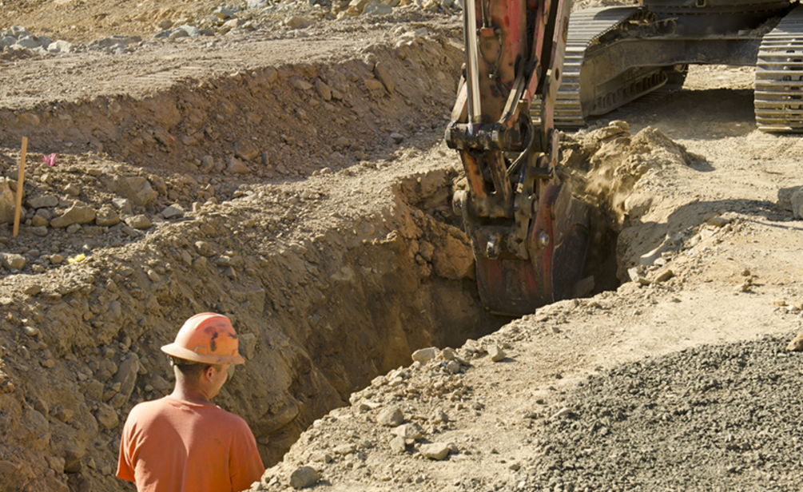
Preparing for an OSHA Visit
Complaints/Referrals
Encourage employees to report problems
Have active suggestion box (Survey Monkey)
Involve employees on Safety Committee
May need IH testing
Consider an incentive program
  Must not drive injury reporting underground
  Encourage reporting of problems for “Safety Bucks”

Slide 21
Preparing for an OSHA Visit
Targeted inspections
Is your operation on a national emphasis program?
Learn about specific inspection instructions
  “This Instruction provides guidance to the Occupational Safety and Health
  Administration (OSHA) national, regional, and area offices for performing
  compliance inspections involving OSHA’s…”
  Combustible dust OSHA Instruction CPL 03-00-008
  Hazardous machinery OSHA Instruction CPL 03-00-019
Understand what OSHA focuses on
  https://www.osha.gov/dep/neps/nep-programs.html
  https://www.osha.gov/pls/oshaweb/owasrch.search_form?p_doc_type=DIRECTIVES&p_toc_level=2&p_keyvalue=CPL
Notes:
Others include:
Hexavalent Chromium OSHA Instruction CPL 02-02-076
Lead OSHA Instruction CPL 03-00-009
Process Safety Management OSHA Instruction CPL 03-00-021
Silica OSHA Instruction CPL 03-00-007
Trenching & Excavation

Slide 22
Preparing for an OSHA Visit
Follow-up Inspections
Were you previously cited by OSHA?
  OSHA may check for abatement
    Quickly correct violative conditions
    Notify OSHA when those condition(s) have been abated

Slide 23
Planning for an OSHA Visit
Develop a response plan
Create a receptionist plan
  How to greet inspector
  Where to have them wait
  Create an OSHA Team
    ID Members
    ID Responsibilities

Slide 24
Planning for an OSHA Visit
OSHA Response Team Responsibilities:
  Understand inspection process
  Attend opening / closing conferences
  Accompany the CSHO
  Record all aspects of the walkaround
Notes:
Whoever is chosen to participate in the inspection, make sure they understand the process and can
Attend opening / closing conferences
Accompany the CSHO
Record all aspects of the walkaround
Photographs (same photos that inspector takes)
Responding to all document requests
Attending management employee interviews

Slide 25
Planning for an OSHA Visit
  OSHA Response Team Responsibilities:
  Take photographs (same photos that inspector takes)
  Attend management employee interviews
  Respond to all document requests
  Ensure violations are abated
Notes:
Whoever is chosen to participate in the inspection, make sure they understand the process and can
Attend opening / closing conferences
Accompany the CSHO
Record all aspects of the walkaround
Photographs (same photos that inspector takes)
Responding to all document requests
Attending management employee interviews

Slide 26
Managing an OSHA Visit
The CSHO arrives
Receptionist greets and receives the CSHO
Checks Officer’s credentials
Contacts OSHA office to confirm official business
Briefly explains company policy of notifying corporate
Notes:
Receiving a CSHO - continued
Train your receptionist on:
Who to notify (and what to do if they’re out)
CEO
Safety Director
Plan Manager
Employee Representative
Waiting area or conference room
Walk them to conference room…
Don’t allow the Officer to walk around

Slide 27
Managing an OSHA Visit
CSHO arrival – continued
Receptionist has CSHO wait in predetermined location
    Lobby
    Conference Room
Receptionist doesn’t allow Officer to walk around

Slide 28

Managing an OSHA Visit
CSHO arrival – continued:
Receptionist uses phone tree to notify OSHA Team:
  CEO
  Legal Department
  Safety Director
  Plant Manager
  Employee Representative
Notes:
Have a list of phone numbers for receptionist

Slide 29
Managing an OSHA Visit
Assemble frequently requested documents:
OSHA 300 Log & OSHA 300A Summary and 301 Injury/Illness Incident Report
Safety Program (IIPP)
  Current
  Reviewed at least annually
Accident investigation reports
Job hazard analyses
Contract Agreements
  Sub-contractors
  Staffing agencies
Training records
  Quizzes/Rosters
  Computer based training
Notes:
(provide only requested documents)

Slide 30
Managing an OSHA Visit
OSHA Team (or team member) attends opening conference
Participates in walkaround
  Makes notes of Officer’s observations
  Takes side-by-side photos
  Asks clarifying questions
  Corrects violations immediately if possible
If possible, participates in mgmt. employee interviews

Slide 31
Managing an OSHA Visit
OSHA Team or team member attends the closing conference
  Asks clarifying questions about potential citations
  Notes which documents are requested

Slide 32
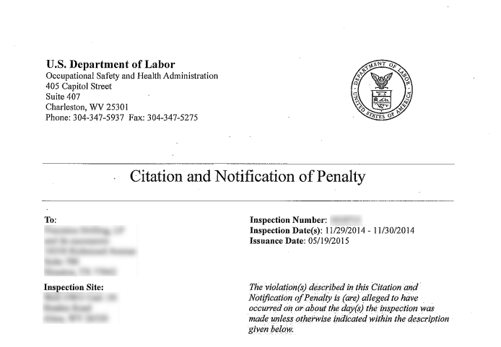
Managing an OSHA Visit
Assemble and send any remaining documents as requested
If you receive a citation
  Post the citation
  Abate the violation
  Post abatement results

Slide 33
Managing an OSHA Visit
OR…
Decide with legal if you will contest the citation (15 days)
Post intention to contest
Informal conference
Citation deleted or upheld
If upheld, abate the violation

Slide 34
Managing an OSHA Visit
SPECIAL CASE: Serious, fatal, or catastrophic incidents
Remember: Compliance visits after fatal/catastrophic incident:
  Have all the basic information gathered before you call OSHA
  Report to OSHA
  Notify OSHA “Response Team”
  Review responsibilities
  Pull most requested documents together
Notes:
Serious, fatal or catastrophic incidents must be reported to OSHA
Have all the basic information gathered before you call.
Pull most requested documents together
Consider having a spokesperson and a “media plan”…what will be released (We are investigating)

Slide 35
Top 10
OSHA Citations

Slide 36
TOP 10 OSHA Citations
1926.501 – Fall protection - 6,929
1910.1200 – Hazard communication - 5,677
1926.451 – Scaffolds - 3,906
1910.134 – Respiratory protection - 3,585
1910.147 – Lockout/tagout - 3,414
1910.178 – Powered industrial trucks - 2,860
1926.1053 – Ladders - 2,639
1910.212 – Machine guarding - 2,451
1910.305 – Electrical wiring - 1,940
1910.303 – Electrical, general requirements - 1,704

Slide 37
Fall Protection
1926.501 – Fall protection - 6,929
Sections cited:
  1926.501(b)(1) Unprotected sides/edges
  1926.501(b)(4)(i) Holes & skylights
  1926.501(b)(10) Roofing work on low-slope roofs
  1926.501(b)(11) Steep roofs
  1926.501(b)(13) Residential construction

Slide 38
Hazard Communication
1910.1200 – Hazard communication - 5,677
Sections cited:
  1910.1200(e)(1) Implementation of a hazard communication program
  1910.1200(g)(1) Requirement to develop Safety Data Sheets (SDS)
  1910.1200(g)(8) Requirement to maintain Safety Data Sheets (SDS)
  1910.1200(h)(1) Training
  1910.1200(h)(3)(iv) Explanation of label received on shipping containers

Slide 39
Scaffolds
1926.451 – Scaffolds - 3,906
Sections cited
  1926.451(b)(1) Working levels of scaffolds shall be fully planked/decked
  1926.451(e)(1) Cross-braces shall not be used as a means of access.
  1926.451(g)(1) Each employee…shall be protected from
  1926.451(g)(1)(vii) Personal fall arrest systems or guardrail systems
  1926.452(g)(4)(i) Guardrail systems shall be installed along…sides and ends

Slide 40
Respiratory Protection
1910.134 – Respiratory protection - 3,585
Sections cited
  1910.134(c)(1) Respiratory protection requirement
  1910.134(c)(2)(i) Employer must establish respiratory program
  1910.134(d)(1)(iii) The employer shall identify and evaluate the respiratory
  hazards(s) in the workplace
  1910.134(e)(1) Medical evaluation for respiratory protection
  11910.134(f)(2) Respirator fit testing

Slide 41
Lockout/Tagout
1910.147 – Lockout/tagout - 3,414
Sections cited
  1910.147(c)(1) Energy control program
  1910.147(c)(4)(i) General procedures
  1910.147(c)(6)(i) Employer shall conduct periodic inspection
  1910.147(c)(7)(i) Training
  1910.147(c)(7)(i)(A) Each authorized employee shall receive training…

Slide 42
Powered Industrial Trucks
1910.178 – Powered industrial trucks - 2,860
Sections cited
  1910.178(l)(1)(i) Safe operation
  1910.178(l)(1)(ii) Training shall consist of formal, practical and evaluation
  1910.178(l)(4)(iii) Evaluation for operators at least once every 3 years
  1910.178(l)(6) Certification
  1910.178(p)(1) Truck repair and maintenance

Slide 43
Ladders
1926.1053 – Ladders - 2,639
Sections cited
  1926.1053(b)(1) Portable ladder access
  1926/1053(b)(4) …used only for the purpose for which they are designed
  1926.1053(b)(13) The top or top step of a step ladder not used as a step
  1926.1053(b)(16) With structural defects
  1926.1053(b)(22) An employee shall not carry any object or load…

Slide 44
Machine Guarding
1910.212 – Machine guarding - 2,451
Sections cited
  1910.212(a)(1) One or more methods of machine guarding
  1910.212(a)(3)(ii) Point of operation
  1910.212(a)(5) Exposure of blades less than 7 feet shall be guarded
  1910.212(b) Anchoring fixed machinery

Slide 45
Electrical Wiring
1910.305 – Electrical wiring - 1,940
Sections cited
  1910.305(b)(1)(i) Conductors protected from abrasion and openings
  effectively closed
  1910.305(b)(1)(ii) Openings shall be effectively closed
  1910.305(b)(2)(i) covers and canopies
  1910.305(g)(2)(iii) Flexible cords and cable (strain relief)
  1910.305(g)(1)(iv)(A) Substitute for fixed wiring of structure

Slide 46
Electrical, General Requirements
1910.303 – Electrical, general requirements - 1,704
Sections cited
  1910.303(b)(2) Installation and use
  1910.303(g)(1) Space about electrical equipment
  1910.303(g)(1)(ii) Working space requirements
  1910.303(g)(2)(i) Guarding of live parts
  1910.303(f)(2) Services, feeders and branch circuits legibly marked

Slide 47
VOSHA Top Ten

Slide 48
VOSHA Construction Ten 2020
Standard Citations Inspections Penalty Description
173 64 $428,268 All Standards cited for Construction
19260451 31 13 $65,574 General requirements.
19260501 26 26 $74,531 Duty to have fall protection.
19261153 21 6 $46,176 --- No Description Found ---
19260503 19 19 $1,621 Training requirements.
19260602 8 7 $25,086 Material handling equipment.
19260405 6 4 $9,534 Wiring methods, components, and equipment for general use.
19260453 6 6 $21,849 Aerial lifts.
19260454 6 5 $4,375 Training requirements.
19260651 6 4 $48,716 Specific Excavation Requirements.
19260652 5 5 $40,216 Requirements for protective systems.
Notes:
“Temporary worker" host employer/staffing agency employment structure
CSHOs to:
Determine if there are temporary workers
Determine if trained in a language/vocabulary they understand
Determine if exposed to violative conditions
Document supervising structure – who provides day-to-day supervision
Document name of the temporary workers' staffing agency

Slide 49
VOSHA Priorities and Directives
Noise in the Workplace
Powered Industrial Trucks
Cranes in Construction
Fall Hazards
Residential Construction
Trench and Excavations
Work zones

Slide 50
VOSHA and COVID
SEC.5.
Duties
(a)Each employer --
\shall furnish to each of his employees employment and a place of employment which are free from recognized hazards that are causing or are likely to cause death or serious physical harm to his employees;
(2)shall comply with occupational safety and health standards promulgated under this Act.
(b)Each employee shall comply with occupational safety and health standards and all rules, regulations, and orders issued pursuant to this Act which are applicable to his own actions and conduct.

Slide 51
Employer Relationship & Responsibilities
COVID Host Employer Responsibilities
  Provide safe & healthy work environment
  Conduct hazard assessment
  Provide site- and equipment-specific training
  Select and provide PPE

Slide 52
Summary
We covered…
Why OSHA visits
Understanding the inspection process
Preparing for the OSHA visit
Managing the unannounced visit from OSHA
Top 10 OSHA Citations
VOSHA’s Top Ten

Slide 53
Whatsoever thy hand findeth to do, do it with thy might
As always, the Associated General Contractors of Vermont is committed to helping you create a safe working environment and safety culture for you and your employees.
Associated General Contractors of Vermont
P O Box 750 Montpelier, Vermont 05601
www.agcvt.org
Please call AGC/VT on their safety help-line 1-802-229-9189 or email them at rjw@agcvt.org for assistance

